Slide 1

DA 204o: Data Science in Practice Course Project Final Presentation Store Sales Forecasting
Aditya Mukhopadhyay, IISC, adityam@iisc.ac.in
Ankit Kumar, IISC, ankitkumar18@iisc.ac.in
Sanjay Kumar, IISC, ksanjay@iisc.ac.in

Slide 2
Problem Definition
Walmart's Scale and Challenges:
One of the largest global retail chains
Faces challenges in managing inventory, operations, and customer demand
Dynamic Retail Industry:
Sales influenced by seasonal trends, holidays, promotions, and economic conditions
Importance of Accurate Sales Forecasting:
Essential for maintaining balance between supply and demand
Prevents overstocking (increased holding costs and markdowns)
Avoids stockouts (lost sales and dissatisfied customers)
Background

Slide 3
Problem Definition
1
Inventory Management
Operational Planning
Customer Satisfaction
Cost Savings
Strategic Decision-Making
3
Ensures supply meets demand accurately.
Reduces holding costs and markdowns.
Prevents lost sales and customer dissatisfaction.
Aids in better workforce planning and resource allocation.
Ensures product availability during peak periods.
Why is it important?
What is the objective?
How can Data Science solve the problem?
2
Accurately Predict Weekly Sales
Understand Influencing Factors
Optimize Inventory Levels
Improve Operational Efficiency Enhance
Customer Satisfaction

Slide 4
Data Collection and Preparation
1
Dataset Origin:
The dataset is from Kaggle (Walmart Sales Dataset)
Data Collection:
Collected from Walmart stores across different locations.
Includes historical sales data, promotional details, holiday schedules, and other relevant factors.
2
Features:
Size:
421,570 rows and 17 columns.
Format:
Numerical and categorical variables.
Store, Dept, Weekly_Sales, Size, and markdown features are numerical.
Type is categorical, Date is datetime, and IsHoliday is boolean.
Missing Values: Markdown columns have around 50% missing data.
Store: Store number (integer). | Dept: Department number (integer).
Date: Date of the sales (datetime). | Weekly_Sales: Weekly sales (target variable, numerical).
IsHoliday: Indicates holiday week (boolean). | Type: Type of store (categorical).
Size: Store size (numerical). | MarkDown1-5: Promotional discounts (numerical).
Temperature, Fuel_Price, CPI, Unemployment: Weather and economic indicators (numerical).
Data Source
Data Description

Slide 5
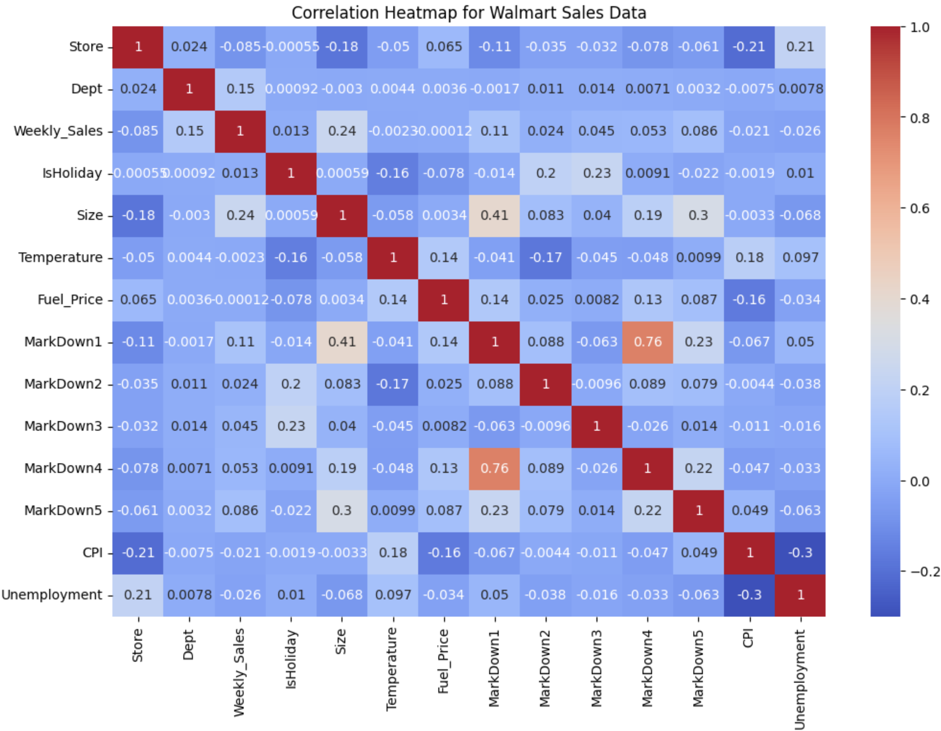
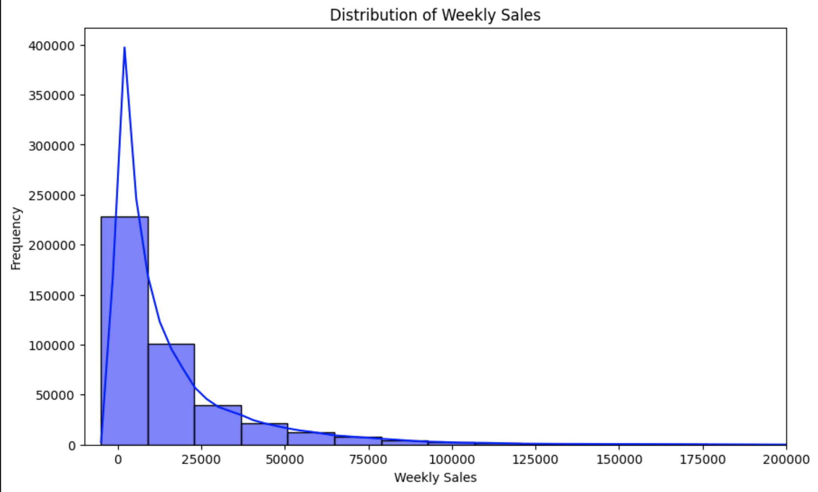
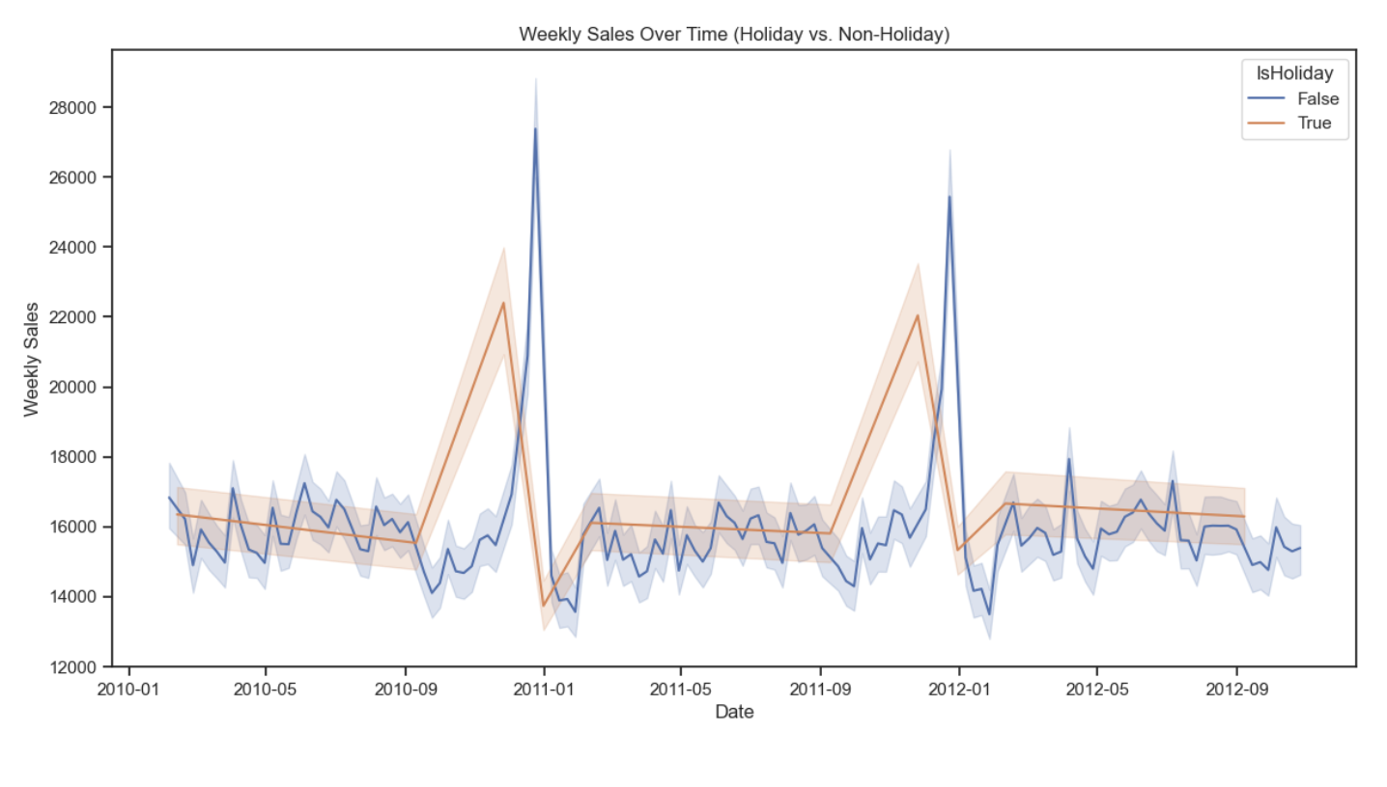
Methodology
Train.csv
Stores.csv
Features.csv
Complete Dataset
Explorative Data Analysis
Imputing
Checking correlation
Checking Data Skewness
Final Dataset
Train (75%)
Test (25%)

Slide 6
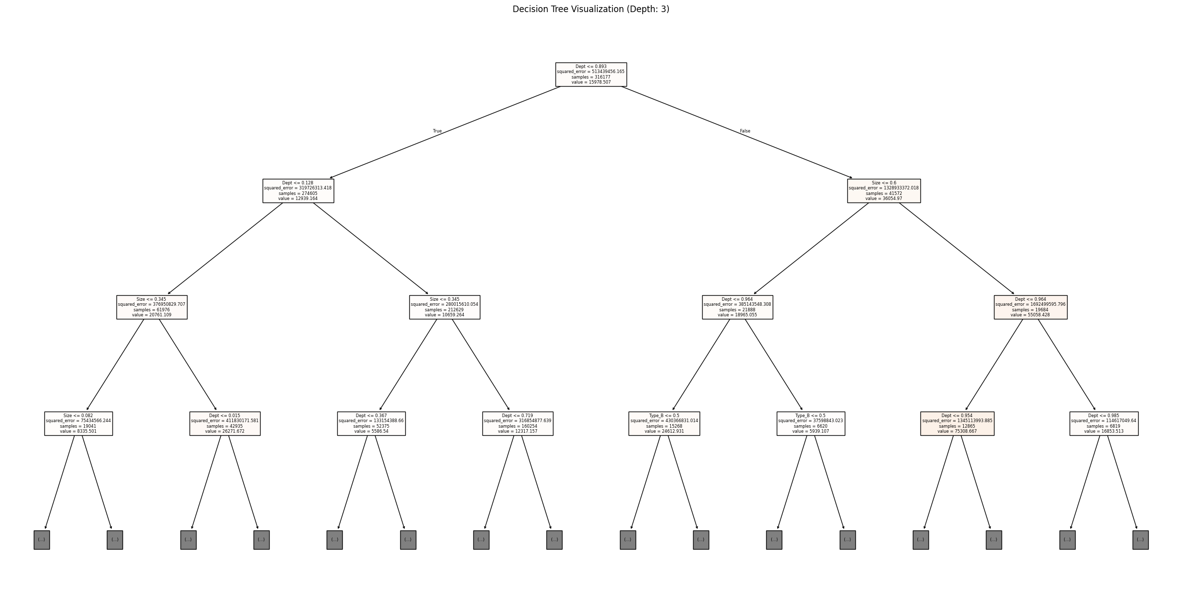
Methodology
ASPECT | Decision Tree | Random Forest
Hyperparameter used | max_depth:3 min_sample_split: default Min_sample_leaf: deafult | N_estimator: 100, Max_depth: None Min_sample_split: default Min_sample_leaf: default
Feature Importance | Derived from tree.features_importance_ | Derived from rf.features_importance_
Training RMSE | 4.47324e-17 | 1429.52742
Validation RMSE | 5280.93931 | 3883.02206
Model Implementation

Slide 7
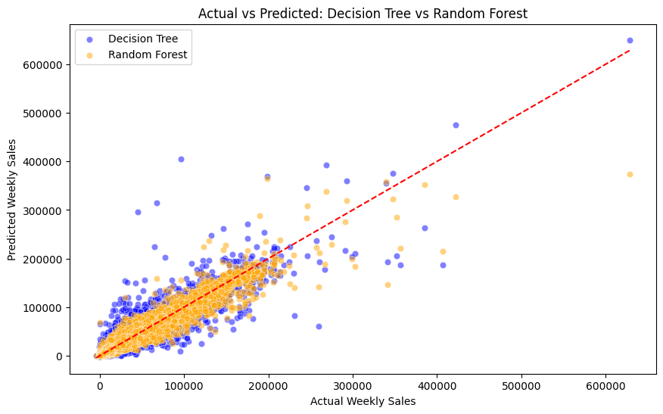
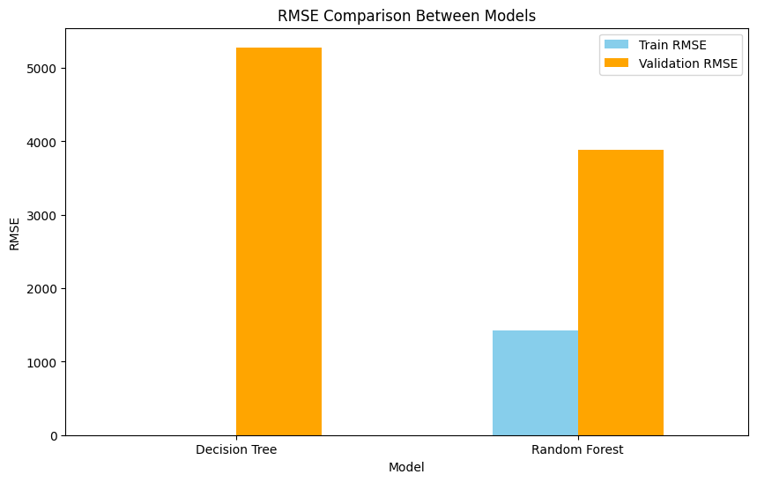
Methodology
Points | Random Forest Regressor(Hyper parameter tuned)
1. RMS error in training Data | 4092
2. RMS error in testing Data | 3917
3. RMSE Comparison
4. Top 5 Imporatant features Predicted | Dept 0.772697 Size 0.188935 Week 0.014801 Type_B 0.012020 Month 0.005834
5. Actual vs Predicted
Model EVALUATION

Slide 8
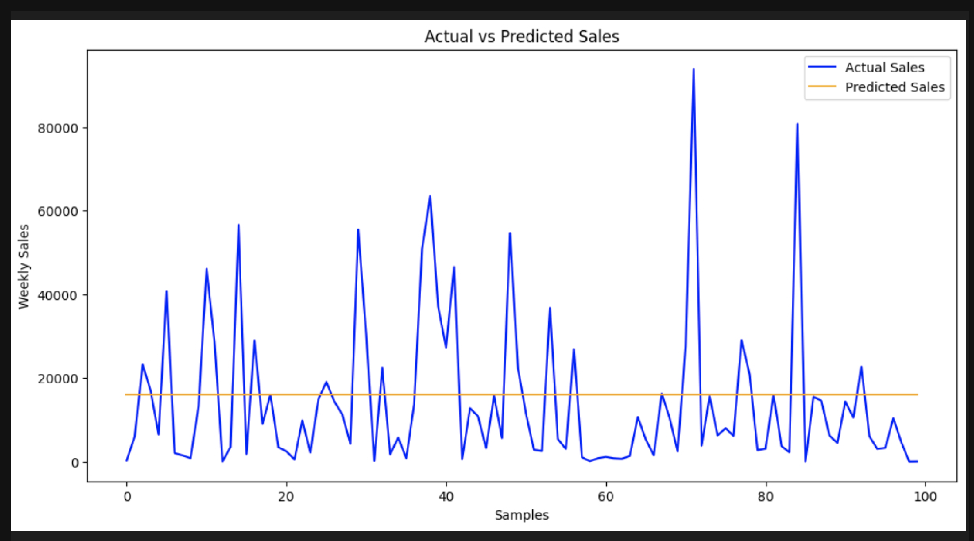
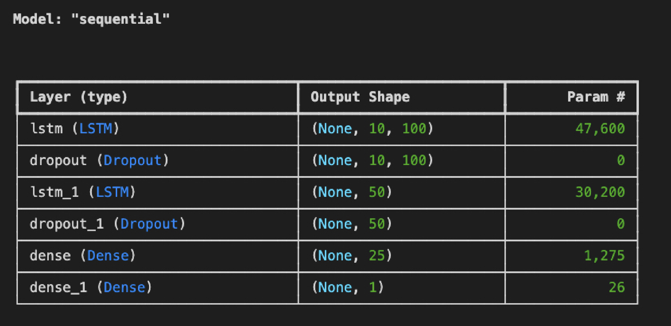
Methodology
ADDITIONAL MODELS TRIED

Slide 9
Challenges and Risks
1
Data quality issues:
Missing, inconsistent, or incomplete data
Complexity of influencing factors:
Numerous factors affecting sales (promotions, holidays, economic conditions)
Seasonal and trend variability:
Significant variations in patterns across stores and departments
Model overfitting:
Good performance on training data but poor on unseen data
Changing market conditions:
Impact of unexpected market or consumer behaviour changes on model accuracy
2
Potential Difficulties
Steps for Mitigation
Data Quality Issues:
Implemented rigorous data cleaning, preprocessing, and imputation methods.
Complexity of Influencing Factors:
Performed extensive EDA and feature engineering to capture sales dynamics.
Seasonal and Trend Variability:
Use advanced time series models and hierarchical forecasting methods.
Model Overfitting:
Employ cross-validation and regularize models with hyperparameter tuning.
Changing Market Conditions:
Continuously monitor and retrain the model with adaptive algorithms.

Slide 10
Role and Responsibilities
Data Collection:
Collect historical sales data, promotional information, holiday schedules, and external factors like weather or economic data.
Data Cleaning:
Handle missing values, detect outliers, and resolve data inconsistencies to ensure a clean dataset.
Feature Engineering:
Create new features such as lagged sales, rolling averages, and holiday impact flags to enhance model performance.
Exploratory Data Analysis (EDA):
Analyze patterns, trends, and correlations in the data to gain insights and inform model selection.
Model Development, Optimization and Evaluation:
Perform cross-validation and hyperparameter tuning to optimize model performance and prevent overfitting.
Evaluate model performance:
Using metrics like Mean Squared Error (MSE), and Root Mean Squared Error (RMSE).
Feature Engineering:
Engineer new features that capture the dynamics of sales, such as lagged sales, moving averages, and holiday indicators.
Model Research and Selection:
Research and select appropriate machine learning and time series models for sales forecasting.
Model Development:
Develop and train models
Ankit Kumar
Sanjay Kumar
Aditya Mukhopadhyay

Slide 11
Data Science Canvas |  |  | Project: | Store Sales Forecasting
 |  |  | Team: | Ankit Kumar, Sanjay Kumar, Aditya Mukhopadhyay
Problem Statement |  |  |  | Execution & Evaluation |  | Data Collection & Preparation
Business Case & Value Added Which business case should be analyzed and what added value does it generate? - Predicting Store Sales Data - Improves Sales Prediction and Helps in optimizing workforce utilization and reducing product loss | Model Selection Which analysis methods can be considered on the basis of the specific data landscape and the business case? - Random Forest Decision Tree Random Search LSTM Autogluon | Model Requirements Which model requirements must be complied with in order to obtain a valid model? No model requirements. We have structured the code in order such that if interpreted sequentially would result in proper training and prediction | Skills What skills are needed to provide the data and model development? The skills needed for data and model development include proficiency in pandas, numpy, and ETL for data handling, seaborn and matplotlib for exploratory data analysis (EDA), linear regression, LSTM, and AutoGluon for model development, and the use of metrics like RMSE for model evaluation. | Model Evaluation Which indicators require quality control and validation and how should they be interpreted? Is real-time monitoring necessary? Performance Metrics: Precision, recall, F1-score, and RMSE for validation. Realtime Monitoring Necessary: Monitor for data drift, latency, and prediction quality using tools like MLflow. | Data Storytelling What requirements does the target group have for the presentation of the results and how do I effectively communicate this data? Target Group Requirements Clarity: Simple visuals and concise insights. Relevance: Tailor data to their goals or challenges. Actionability: Highlight actionable recommendations. Effective Communication Use clear charts (e.g., bar, line, heatmaps). Focus on key takeaways; avoid jargon. Tell a story: Problem → Insight → Solution | Data Selection & Cleansing Which of the available data is relevant? Do the data have to be cleaned up? Available data is sparse but provides relevant information required for prediction but not enough for forecasting. The data has discrepancies and has been cleaned up in our EDA process. | Data Collection How and with which methods should additionally required data be collected? What properties has this data to fulfil? Methods: Track: Foot traffic (IoT), competitor prices (web scraping), weather & economic data (APIs), holidays/events (scraping), inventory data (system integration). Properties: Relevant to sales, accurate (error-free), timely (updated regularly), granular (store-level), complete (minimal missing data), scalable for growth.
Data Landscape Which data is required for this and which is already available? Which additional data has to be collected? The data has been collected from Kaggle. The data we found had a cumulative 40days of unique data which resulted in inaccuracies. We avoided usage of synthetic data creation to fill in gaps to keep the project close to real world accurate. Additional data that can be collected is a timeseries data over a year to get seasonal trends and help in better prediction |  | Software & Libraries Which software should be used? Is there already a standard solution? Which libraries are used? Python Scikitlearn Pandas Matplotlib Numpy Tensorflow Joblib |  |  |  | Data Integration In which system should the data from different sources be migrated? All data collected should be added to dataset folder based on which the EDA system will merge and work on the data | Explorative Data Analysis Outliers/Structures: Outliers: Extreme values in Weekly_Sales, Temperature, Fuel_Price, MarkDown1-5. Structures: Seasonality, store types, economic factors, holidays. Key Figures: Summary Stats: Mean, median, mode, and standard deviation. Missing Data: Count and percentage of missing values. Distribution: Histograms and boxplots for Weekly_Sales and other variables. Correlation: Heatmap for sales vs external factors. Outliers: Z-Score or IQR detection.

Slide 12
Proposed Methodology
1
Decsion Tree Regressor
Random Forest Regressor
Gradient Boosting Regressor
XGBoost
CatBoost
Voting Regressor
Stacking Regressor
2
Methods/ Models to Use
Technologies to Use
pandas: For data manipulation and preprocessing.
NumPy: For numerical computing.
scikit-learn: For machine learning algorithms, preprocessing, and evaluation metrics.
Matplotlib and Seaborn: For data visualization.
XGBoost, LightGBM, and CatBoost: For boosting algorithms.
PCA: for reducing the feature space
Notes:
Entire slide empty

Slide 13
Implementation Plan
1
Data Collection
Model Building
Data Preprocessing
Model Evaluation
Project Phases
Resources
2
Software & Tools: Python (Language) and Jupyter Notebook / VSCode (Development Environment)
Libraries:
pandas, numpy (Data Manipulation)
matplotlib, seaborn (Visualization)
scikit-learn, xgboost, lightgbm, catboost (Machine Learning & Modeling)
PCA (Dimensionality Reduction)
Hardware: Local Machine
Data: Walmart Sales Dataset (Primary Dataset from Kaggle)
Notes:
Resources necessary

Slide 14
Implementation Plan
WEEK 1
Data Collection
WEEK 2
Data Preprocessing
WEEK 4
Model Implementation
WEEK 3
Model Selection
Timeline And Milestones
WEEK 5
Model Implementation
WEEK 6
Model Evaluation

Slide 15
Expected Outcome
1
Accurate Weekly Sales Forecasts:
Develop highly accurate models for predicting weekly sales.
Improved Inventory Management:
Optimize stock levels to reduce overstocking and stockouts.
Enhanced Operational Planning:
Provide insights for effective workforce planning and resource allocation.
Increased Customer Satisfaction:
Ensure product availability, especially during peak periods.
Data-Driven Decision Making:
Equip stakeholders with reliable forecasts for strategic planning and marketing.
2
Expectations
Measuring Success
Forecast Accuracy:
Evaluate using MAE, MSE, RMSE, and benchmark against baseline models.
Inventory Metrics:
Monitor reductions in overstocking, stockouts, and improvements in turnover rate.
Operational Efficiency:
Assess staffing alignment with forecasts and resource allocation effectiveness.
Customer Satisfaction:
Analyze customer feedback, satisfaction scores, and sales performance during peak periods.
Business Impact:
Calculate cost savings from optimized inventory and measure revenue growth from better stock availability.

